Slide 1
Practice Lab:
This Practice Lab is dependent on Discussion Unit 7612, where most of the objects we create in this lab were introduced.
This Practice Lab is also dependent on Practice Lab 7548/7549, where we generated/used the ability to compile Spark/Scala programs.
This Practice Lab requires a working DSE system, with DSE Analytics enabled.
Because of the streaming nature, this work should be compiled using Maven or an IDE.
A second terminal window is required to run
"nc -lk 9999".
DSE Analytics, Streaming
Notes:
The goal of this Practice Lab is to compile and run a DSE Analytics streaming program

Slide 2
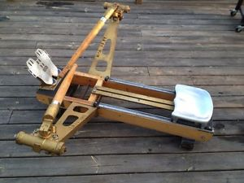
Challenge 1: Prerequisites
Prerequisites:
Instructions are provided for Linux
We will operate below recommended settings; 1 OS node only, minimum 8 GB RAM, 12 GB RAM preferred
That you have an operating single node DSE Analytics cluster.
All work done as ‘root’
Notes:
To complete this Practice Lab, the following is assumed:
All prerequisites and conditions as listed above.
All work is expected to be executed on one OS node (instructions are written for Linux).
Because of resource constraints, it is expected you are running a single DSE Core node (no Graph, Yes Spark, Search) on this single OS node.

Slide 3

Working Goal:
From: Maury_Atwater
To: DSE_HOTSHOT
Subject: Need this now !!!
I need to know we can stream.
Complete the following:
. Compile and run the streaming word count
example; Example 01.
-MA
Maury Atwater, President of Atwater's
Notes:
The email above, lists our working goal.

Slide 4
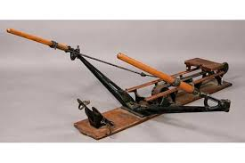
Challenge 1: Compile and Run Example 01
Compile and run the word count, streaming example 01 from Discussion Unit 7612.
Paste into App.scala from 7458/7459. Compile and run as described there.
You'll need a second terminal running "mc –lk 9999", and type text in there when ready
Notes:
To complete this Practice Lab, the following is assumed:
Compile and run the word count, streaming example 01 from Discussion Unit 7612.
Paste into App.scala from 7458/7459. Compile and run as described there.
You'll need a second terminal running "mc –lk 9999", and type text in there when ready

Slide 5

Practice Lab:
Lessons Learned
Notes:
Discuss what worked well, poorly, from the Practice Lab.

Slide 6
End of Unit:
Notes:
End of Practice Lab-

